Slide 1
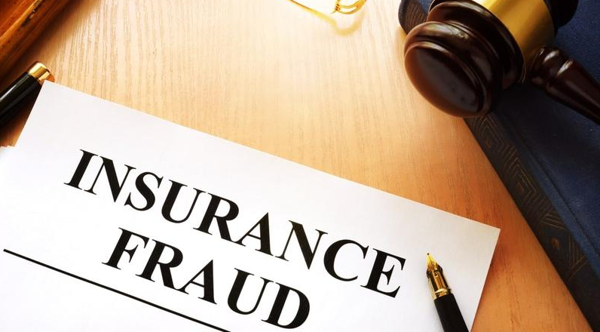
Fraud Vehicle Insurance Claim

Slide 2
Problem Statement
Given a list of customer policy details with claim data, the problem is to identify potentially fraudulent vehicle insurance claims.

Slide 3
Customer data-overview
Data | Description
months_as_customer | Number of months the customer is with the company
age | Age of the customer in years
policy_number | Policy number of the customer
policy_state | State in US where the policy was initiated
policy_annual_premium | Annual premium paid for the policy
umbrella_limit | Limit covered under insurance
insured_zip | Zip code of the insured person
insured_sex | Sex of the insured person(Male/Female)
insured_education_level | Education level of the insured person(high school/Masters/Phd)
insured_occupation | Occupation of the insured person
insured_hobbies | Hobbies of the insured person(Reading/Hiking/skydiving)
insured_relationship | Relationship with insured person(self/spouse/child)

Slide 4
Customer data-overview(contd..)
Data | Description
capital-gains | Gain incurred by the insurance company through the customer
capital-loss | Loss incurred by the insurance company through the customer
incident_date | Date when incident happened
incident_type | Type of incident(Single vehicle/Multi vehicle)
collision_type | Type of collision(Front/Rear/Side)
incident_severity | Severity of the accident(Major/Minor)
authorities_contacted | Authorities informed about the incident(Police/Fire/Ambulance)
incident_state | State in US where the incident happened
incident_city | City in Us where the incident happened
incident_location | Location / address where the incident happened
incident_hour_of_the_day | Time in which the incident happened
number_of_vehicles_involved | Number of vehicles involved in the incident

Slide 5
Customer data-overview(contd..)
Data | Description
property_damage | Is there a property damage(Yes/No)
bodily_injuries | Number of bodily injuries
witnesses | Number of witnesses of the incident
police_report_available | Is there a police report available(Yes/No)
total_claim_amount | Total insurance amount claimed by the customer
injury_claim | Amount claimed for injury
property_claim | Amount claimed for property damage
vehicle_claim | Amount claimed for vehicle damage
auto_make | Company make of the vehicle
auto_model | Company model of the vehicle
auto_year | Year of vehicle make
fraud_reported | Is there a fraudulent claim reported(Yes/No)

Slide 6
Step1:To analyze the below features on which a fraudulent claim is based on.
incident_severity
incident_state
insured_zip
insured_hobbies
insured_occupation
authorities_contacted
auto_model
vehicle_claim
collision_type
incident_type
umbrella_limit
capital-gains

Slide 7
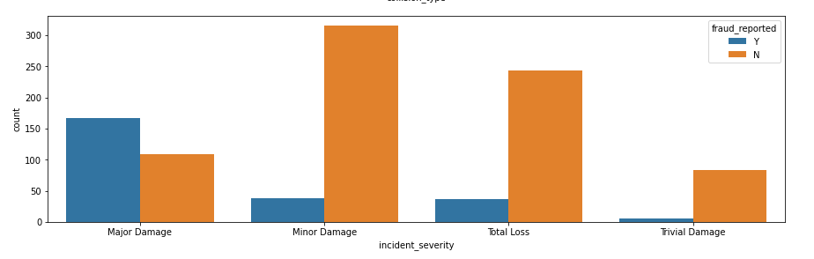
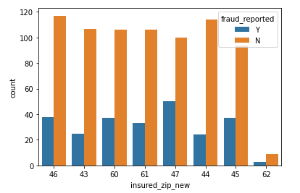
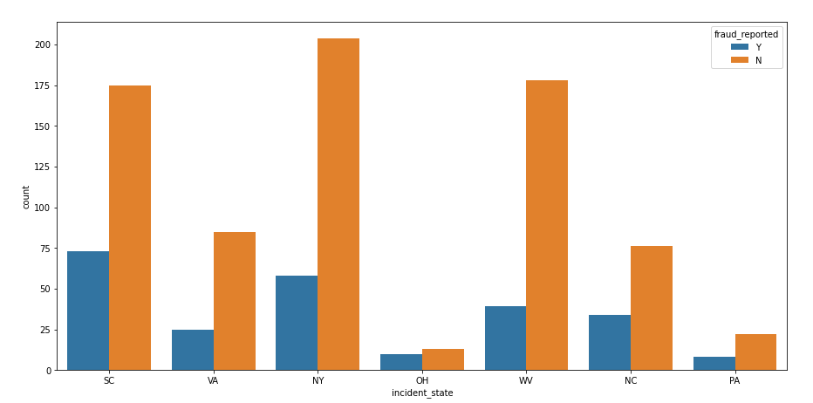
Incident_severity, Incident_state and Insured_zip
Maximum and minimum fraud claims
incident_severity:
Major Damage - 60 percent
Trivial Damage - 6 percent
zipcode:
Starting with 47 – 33 percent
Starting with 43 – 17 percent
incident_state:
OH – 43 percent
WV – 17 percent

Slide 8
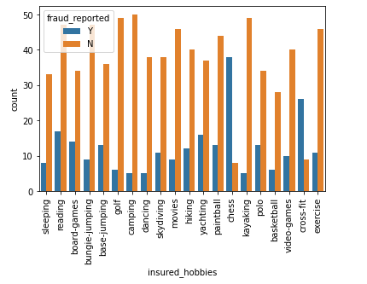
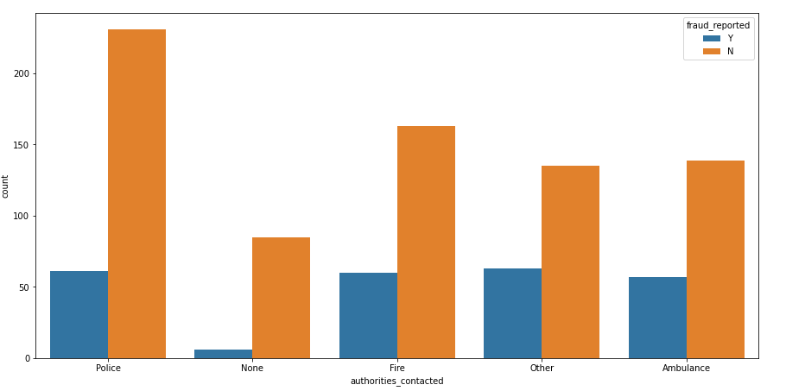
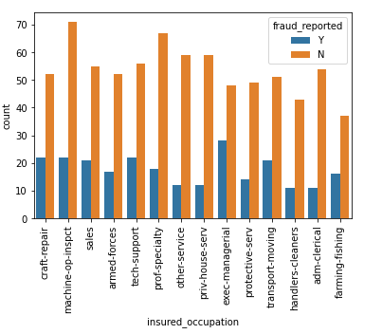
Insured_hobbies, Insured_occupation and Authorities_contacted
Hobbies chess and cross fit has larger number of fraud claims compared to non-fraud claims.
‘exec-managerial’ in insured_occupation has the highest fraud claim percentage of 36 percent.
‘None’ category in authorities_contacted has very less fraud claim of 6 percent.

Slide 9
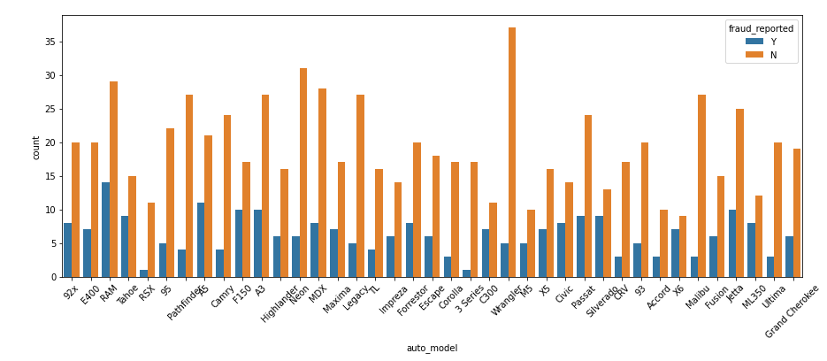
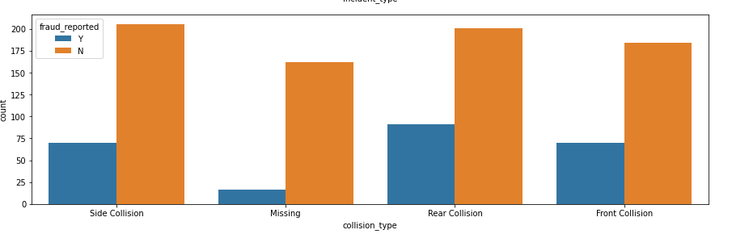
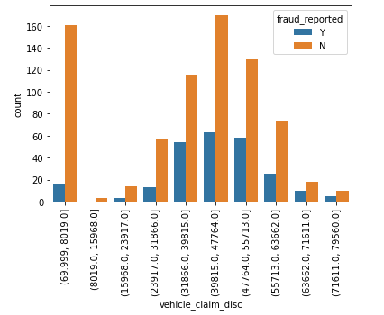
Auto_model, Vehicle_claim and Collision_type
RSX and 3-series auto_model categories have very less percentage of fraud claims compared to other models.
Percentage of people with fraud claim increases with vehicle_claim amount.
When the collision_type is ‘Missing’ fraud claim percentage is very less-6 percent.

Slide 10
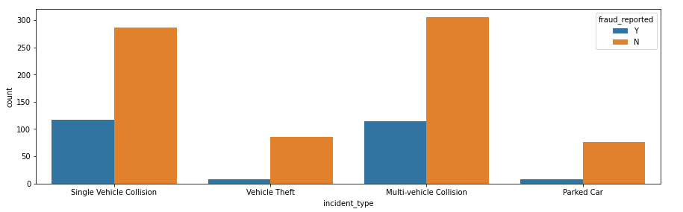
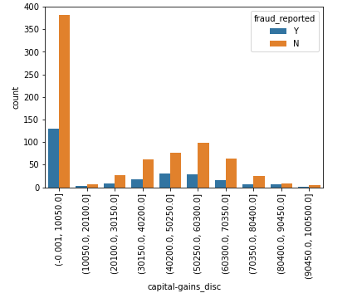
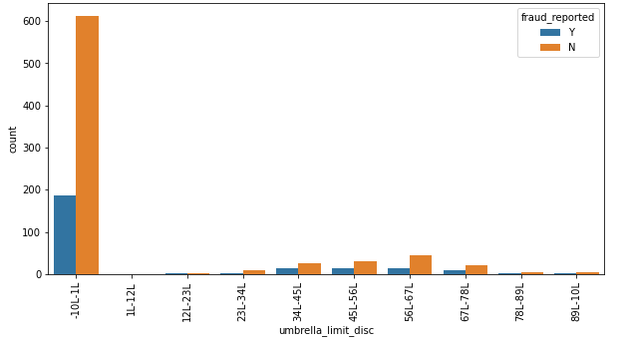
Incident_type, Umbrella_limit and Capital-gains
‘Vehicle Theft’ and ‘Parked Car’ incident types have only 8-9 percent fraud claims.
Percentage of people under 1lakh umbrella limit is very high and fraudulent claim is less in this category compared to other categories .
As the capital-gains increase, percentage of fraudulent claim decreases.

Slide 11
Step2:To analyze the below features which does not impact a fraudulent claim.
age
months_as_customer
policy_number
policy_bind_date
policy_state
policy_csl
policy_deductable
policy_annual_premium
insured_sex
insured_education_level
insured_relationship
capital-loss
incident_date
incident_city
incident_location
incident_hour_of_the_day
number_of_vehicles_involved
property_damage
bodily_injuries
witnesses
police_report_available
total_claim_amount
injury_claim
property_claim
auto_make
auto_year
fraud_reported

Slide 12
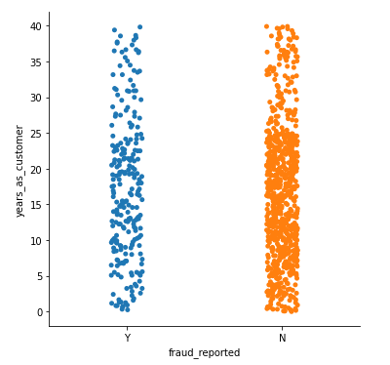
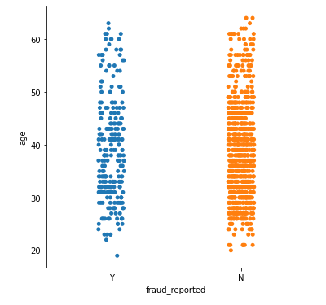
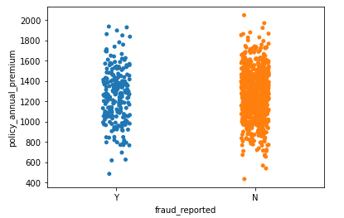
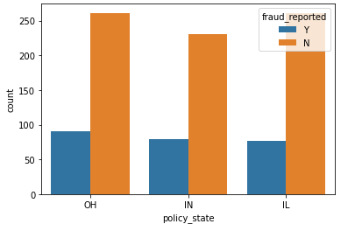
No dependency on target- years_as_customer, age, policy_state, policy_annual_premium

Slide 13
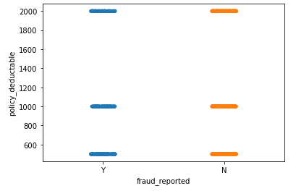
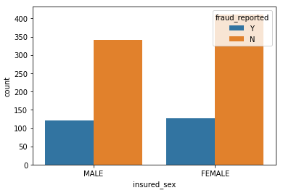
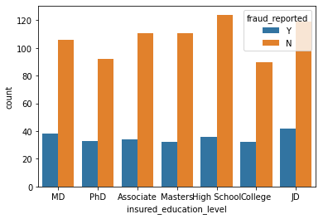
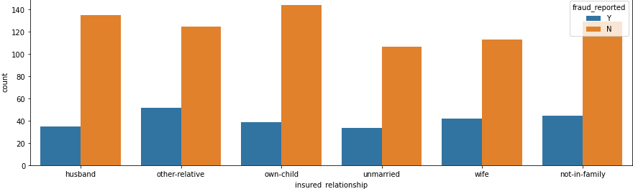
No dependency on target- policy_deductable, insured_sex, insured_education_level, insured_relationship

Slide 14
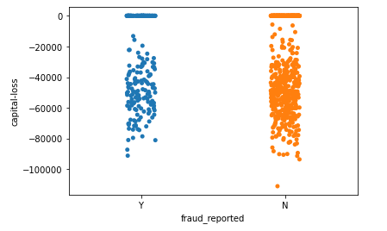
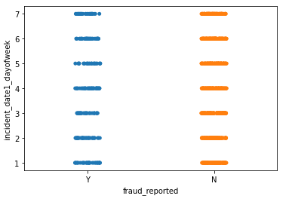
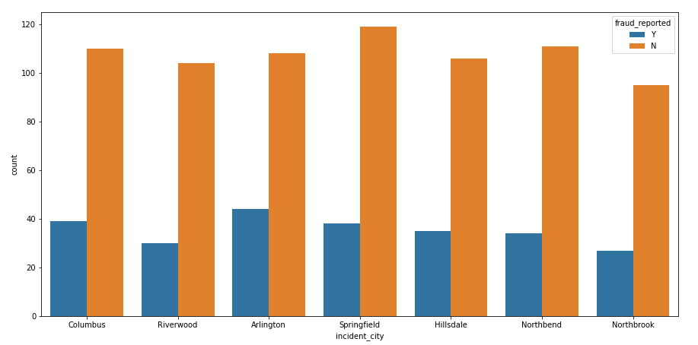
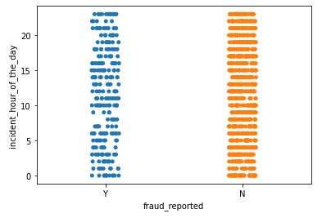
No dependency on target- capital-loss, incident_date, incident_city, incident_hour_of_the_day

Slide 15
No dependency on target- capital-loss, incident_date, incident_city, incident_hour_of_the_day

Slide 16
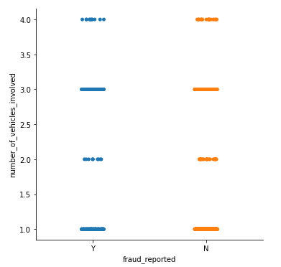
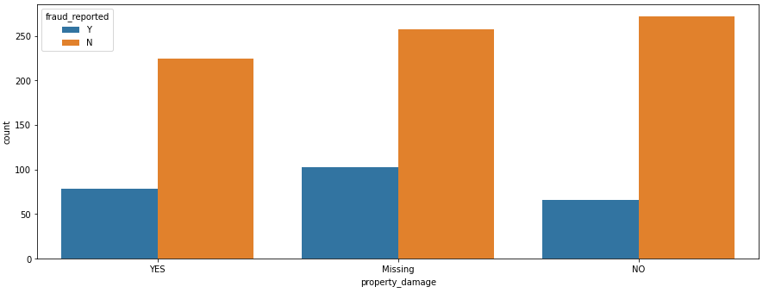
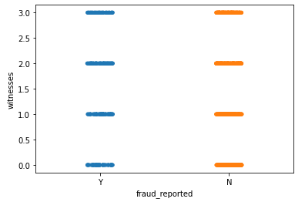
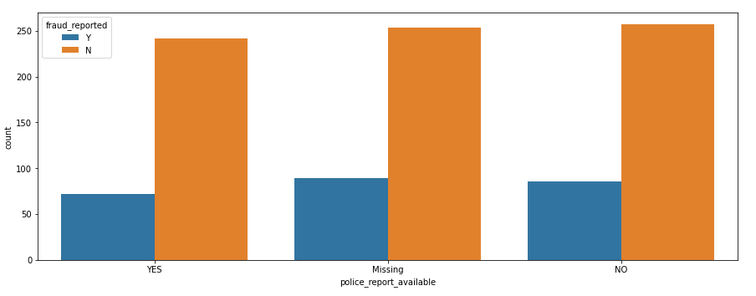
No dependency on target- number_of_vehicles_involved, property_damage, witnesses, police_report_available

Slide 17
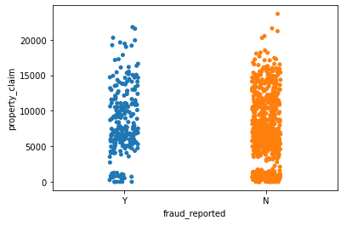
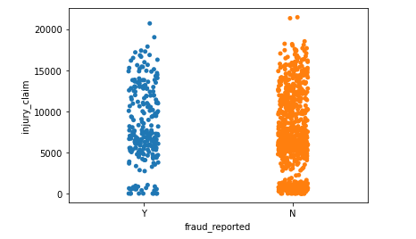
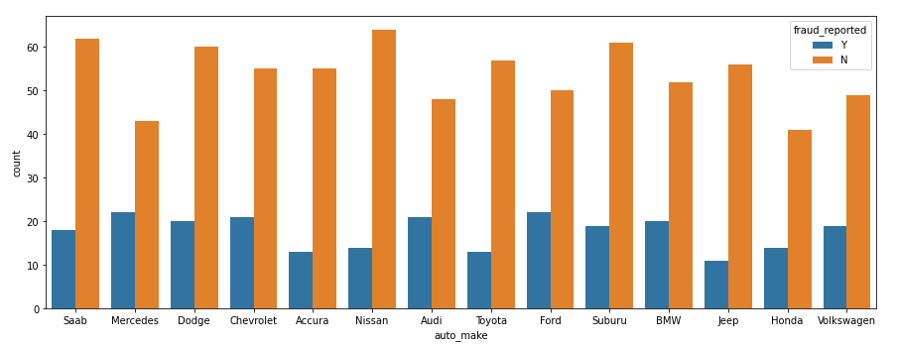
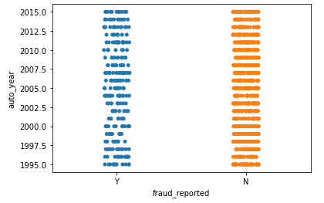
No dependency on target- property_claim, injury_claim, auto_make, auto_year

Slide 18
Conclusion

